Slide 1

INTERNET SECURITY

Slide 2
SYLLABUS
Email Security-PGP-S/MIME- Secured Electronic Transaction-IP Security Overview- IPSec Documents-IPSec Services, IPSec Architecture, IP Traffic Processing-Encapsulating Security Payload-Internet key Exchange- Firewalls- Stateful Packet Inspection- Application Gateways/Proxies- Hybrid Systems

Slide 3
Email Security Enhancements
confidentiality
  protection from disclosure
authentication
  of sender of message
message integrity
  protection from modification
non-repudiation of origin
  protection from denial by sender
Notes:
What we want is something more akin to standard mail (contents protected inside an envelope) if not registered mail (have confidence about the sender of the mail and its contents).

Slide 4
Pretty Good Privacy (PGP)
Pretty Good Privacy (PGP) is an encryption system used for both sending encrypted emails and encrypting sensitive files.
Since its invention back in 1991, PGP has become the de facto standard for email security.
Developed by Phil Zimmermann
PGP was designed to provide all four aspects of security, i.e., privacy, integrity, authentication, and non-repudiation in the sending of email.

Slide 5
PGP uses a digital signature (a combination of hashing and public key encryption) to provide integrity, authentication, and non-repudiation. PGP uses a combination of secret key encryption and public key encryption to provide privacy. Therefore, we can say that the digital signature uses one hash function, one secret key, and two private-public key pairs.
PGP is an open source and freely available software package for email security.
PGP provides authentication through the use of Digital Signature.
It provides confidentiality through the use of symmetric block encryption.
It provides compression by using the ZIP algorithm, and EMAIL compatibility using the radix-64 encoding scheme.

Slide 6

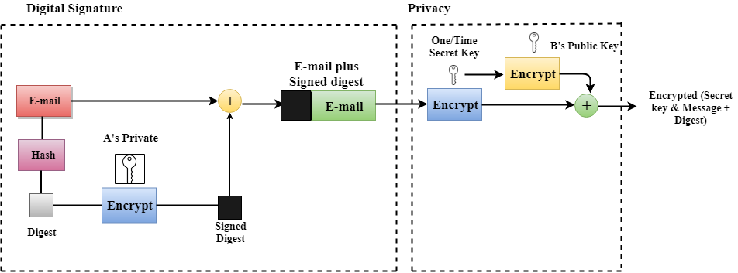
PGP at the Sender site (A)

Slide 7
Following are the steps taken by PGP to create secure e-mail at the sender site
The e-mail message is hashed by using a hashing function to create a digest.
The digest is then encrypted to form a signed digest by using the sender's private key, and then signed digest is added to the original email message.
The original message and signed digest are encrypted by using a one-time secret key created by the sender.
The secret key is encrypted by using a receiver's public key.
Both the encrypted secret key and the encrypted combination of message and digest are sent together.

Slide 8
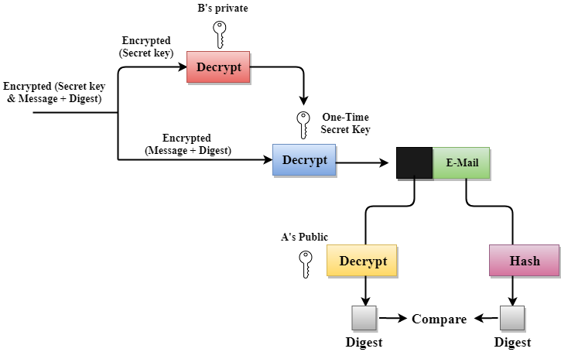
PGP at the Receiver site (B)

Slide 9
Following are the steps taken to show how PGP uses hashing and a combination of three keys to generate the original message:
The receiver receives the combination of encrypted secret key and message digest is received.
The encrypted secret key is decrypted by using the sender's private key to get the one-time secret key.
The secret key is then used to decrypt the combination of message and digest.
The digest is decrypted by using the sender's public key, and the original message is hashed by using a hash function to create a digest.
Both the digests are compared if both of them are equal means that all the aspects of security are preserved.

Slide 10
The following are the services offered by PGP
1. Authentication
2. Confidentiality
3. Compression
4. Email Compatibility
5. Segmentation

Slide 11
PGP Operation – Authentication
Combination of SHA-1 and RSA provides an effective digital signature scheme
Because of the strength of RSA the recipient is assured that only the possessor of the matching private key can generate the signature
Because of the strength of SHA-1 the recipient is assured that no one else could generate a new message that matches the hash code
As an alternative, signatures can be generated using DSS/SHA-1 • Detached signatures are supported
Each person’s signature is independent and therefore applied only to the document

Slide 12
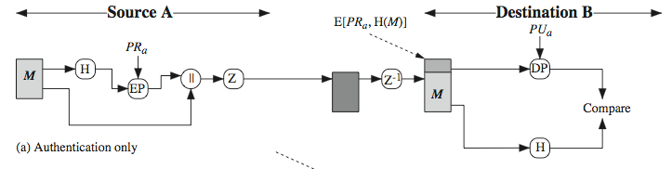
Sender creates message
Make SHA-1 160-bit hash of message
Attached RSA signed hash to message
Receiver decrypts & recovers hash code
Receiver verifies received message hash

Slide 13
PGP Operation – Confidentiality
Provided by encrypting messages to be transmitted or to be stored locally as files
In both cases the symmetric encryption algorithm CAST-128 may be used
Alternatively IDEA or 3DES may be used
The 64-bit cipher feedback (CFB) mode is used
As an alternative to the use of RSA for key encryption, PGP uses ElGamal, a variant of Diffie-Hellman that provides encryption/decryption
Note: In PGP each symmetric key is used only once.
Although referred to as a session key, it is in reality a one-time key
Session key is bound to the message and transmitted with it To protect the key, it is encrypted with the receiver’s public key

Slide 14
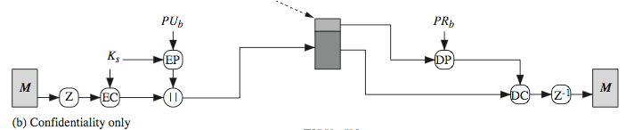
Sender forms 128-bit random session key
Encrypts message with session key
Attaches session key encrypted with RSA
Receiver decrypts & recovers session key
Session key is used to decrypt message

Slide 15
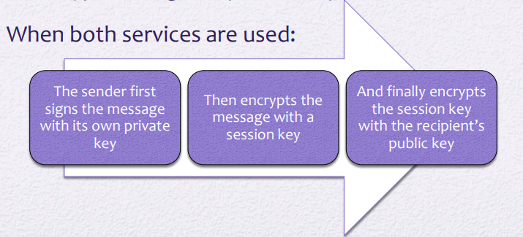
PGP Operation – Confidentiality & Authentication
Both services may be used for the same message
First a signature is generated for the plaintext message and prepended to the message
Then the plaintext message plus signature is encrypted using CAST-128 (or IDEA or 3DES) and the session key is encrypted using RSA (or ElGamal)
When both services are used:

Slide 16
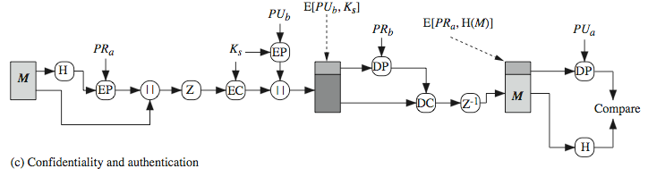
Can use both services on same message
Create signature & attach to message
Encrypt both message & signature
Attach RSA/ElGamal encrypted session key

Slide 17
PGP Operation – Compression
As a default, PGP compresses the message after applying the signature but before encryption
This has the benefit of saving space both for e-mail transmission and for file storage
The placement of the compression algorithm is critical
Applying the hash function and signature after compression would constrain all PGP implementations to the same version of the compression algorithm
Message encryption is applied after compression to strengthen cryptographic security
The compression algorithm used is ZIP

Slide 18
PGP E-mail Compatibility
Many electronic mail systems only permit the use of blocks consisting of ASCII text
To accommodate this restriction, PGP provides the service of converting the raw 8-bit binary stream to a stream of printable ASCII characters
The scheme used for this purpose is radix-64 conversion
Each group of three octets of binary data is mapped into four ASCII characters
This format also appends a CRC to detect transmission errors

Slide 19
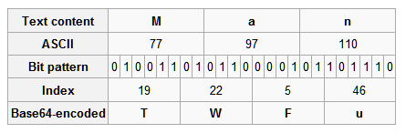
PGP segments messages if too big
PGP produces binary (encrypted) data & appends a CRC
Email was designed only for text ➢Need to encode binary into printable ASCII characters
Uses radix-64 or base-64 algorithm
Maps 3 bytes to 4 printable chars: 26 upper case alphabets, 26 lowercase alphabets, 10 numbers, +, \

Slide 20
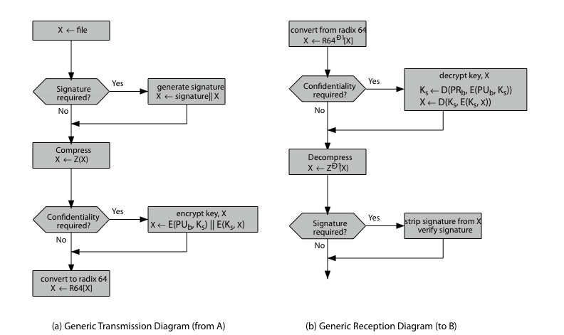
PGP Operation – Summary

Slide 21
PGP Session Keys
Need a session key of varying sizes for each message:
56-bit DES,
168-bit Triple-DES
128-bit CAST (Carlisle Adams and Stafford Tavares)
IDEA (International Data Encryption Algorithm)
Generated with CAST-128 using random inputs taken from previous uses and from keystroke timing of user

Slide 22
PGP Key Rings
each PGP user has a pair of key rings:
  public-key ring contains all the public-keys of other PGP users known to this user, indexed by key ID
  private-key ring contains the public/private key pair(s) for this user, indexed by key ID & encrypted keyed from a hashed passphrase

Slide 23
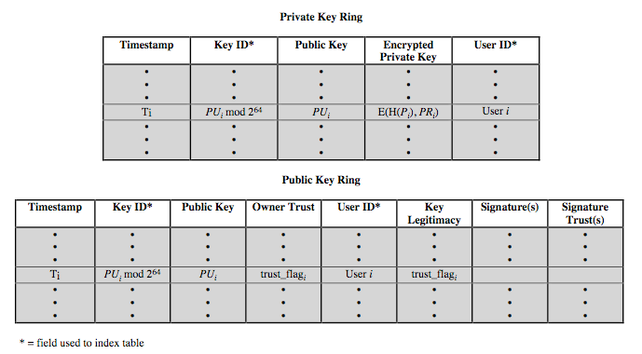

Slide 24
PGP Key Management
rather than relying on certificate authorities
in PGP every user is own CA
  can sign keys for users they know directly
forms a “web of trust”

Slide 25
Disadvantages of PGP Encryption
The Administration is difficult: The different versions of PGP complicate the administration.
Compatibility issues: Both the sender and the receiver must have compatible versions of PGP. For example, if you encrypt an email by using PGP with one of the encryption technique, the receiver has a different version of PGP which cannot read the data.
Complexity: PGP is a complex technique. Other security schemes use symmetric encryption that uses one key or asymmetric encryption that uses two different keys. PGP uses a hybrid approach that implements symmetric encryption with two keys. PGP is more complex, and it is less familiar than the traditional symmetric or asymmetric methods.
No Recovery: Computer administrators face the problems of losing their passwords. In such situations, an administrator should use a special program to retrieve passwords. For example, a technician has physical access to a PC which can be used to retrieve a password. However, PGP does not offer such a special program for recovery; encryption methods are very strong so, it does not retrieve the forgotten passwords results in lost messages or lost files.

Slide 26
S/MIME
S/MIME means Secure/Multipurpose Internet Mail Extensions.
It is a technology that allows us to encrypt the content of our e-mails, so that they are not vulnerable to cyber attacks.
In other words, S/MIME keeps our e-mails safe and makes sure that the only person who reads them is the intended receiver.

Slide 27
S/MIME is a protocol for the secure exchange of e-mail and attached documents originally developed by RSA Security.
Secure/Multipurpose Internet Mail Extensions (S/MIME) adds security to Internet e-mail based on the Simple Mail Transfer Protocol (SMTP) method and adds support for digital signatures and encryption to SMTP mail to support authentication of the sender and privacy of the communication.

Slide 28
S/MIME (Secure/Multipurpose Internet Mail Extensions)
security enhancement to MIME email
  original Internet RFC822 email was text only
  MIME provided support for varying content types and multi-part messages
    Image, video, audio, PS, octet-stream
  S/MIME added security enhancements
have S/MIME support in various modern mail agents: MS Outlook, Netscape etc

Slide 29
S/MIME Functions
Enveloped Data
  Encrypted Content And Associated Keys
Signed Data
  Encoded Message + Signed Digest
Clear-signed Data
  Cleartext Message + Encoded Signed Digest
Signed & Enveloped Data
  Nesting Of Signed & Encrypted Entities

Slide 30
S/MIME Cryptographic Algorithms
Hash functions: SHA-1 & MD5
Digital signatures: DSS & RSA
Session key encryption: D-H & RSA
Message encryption: triple-des, RC2/40 and others
MAC: HMAC with SHA-1
Have a procedure to decide which algorithms to use
  According to the capability of the receiving agent

Slide 31
S/MIME Messages
S/MIME secures a MIME entity with a signature, encryption, or both
Forming a MIME wrapped PKCS object (Public Key Cryptography Standard originally by RSA Inc Now by IETF)

Slide 32
S/MIME Certificate Processing
S/MIME uses X.509 v3 certificates
Managed using a hybrid of a strict X.509 CA hierarchy and enterprise’s CAs
Each client has a list of trusted CA’s certificates and his own public/private key pairs & certificates
Several types of certificates with different levels of checks:
Class 1: Email and web browsing
Class 2: Inter-company email
Class 3: Banking, …

Slide 33
S/MIME Enhanced Security Services
RFC2634 (1999) describes enhanced security services: Signed receipts: Request a signed receipt
Security labels: Priority, which users (role) can access
Secure mailing lists: Request a list processor to encrypt

Slide 34
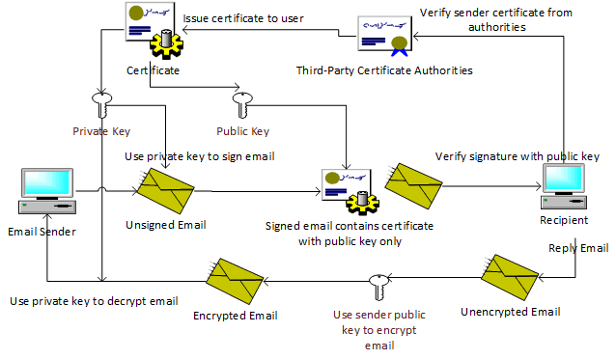
S/MIME Structure

Slide 35
How It Works
S/MIME is an extension of the widely implemented Multipurpose Internet Mail Extensions (MIME) encoding standard, which defines how the body portion of an SMTP message is structured and formatted.
S/MIME uses the RSA public key cryptography algorithm along with the Data Encryption Standard (DES) or Rivest-Shamir-Adleman (RSA) encryption algorithm.
In an S/MIME message, the MIME body section consists of a message in PKCS #7 format that contains an encrypted form of the MIME body parts.
The MIME content type for the encrypted data is application/pkcs7-mime.

Slide 36
Secure Electronic Transaction
An application-layer security mechanism, consisting of a set of protocols.
Protect credit card transaction on the Internet.
Companies involved:– MasterCard, Visa, IBM,
Microsoft, Netscape, RSA, Cyber Cash, Net Bill
Not an ordinary payment system.
It has a complex technical specification

Slide 37
SET Business Requirements
Provide confidentiality of payment and ordering information.
Ensure the integrity of all transmitted data.
Provide authentication that a cardholder is a ultimate
user of a credit card account
Provide authentication that a merchant can accept credit card transactions through its relationship with a financial institution

Slide 38
SET Business Requirements (cont’d)
Ensure the use of the best security practices and system design techniques to protect all legitimate parties in an electronic commerce transaction
Create a protocol that neither depends on transport security mechanisms nor prevents their use
Facilitate and encourage interoperability among software and network providers

Slide 39
Secure Electronic Transaction : Protocol
Confidentiality: All messages are encrypted
Trust: All parties must have digital certificates
Privacy: information made available only when and where
necessary
Developed by Visa and MasterCard
Designed to protect credit card transactions

Slide 40

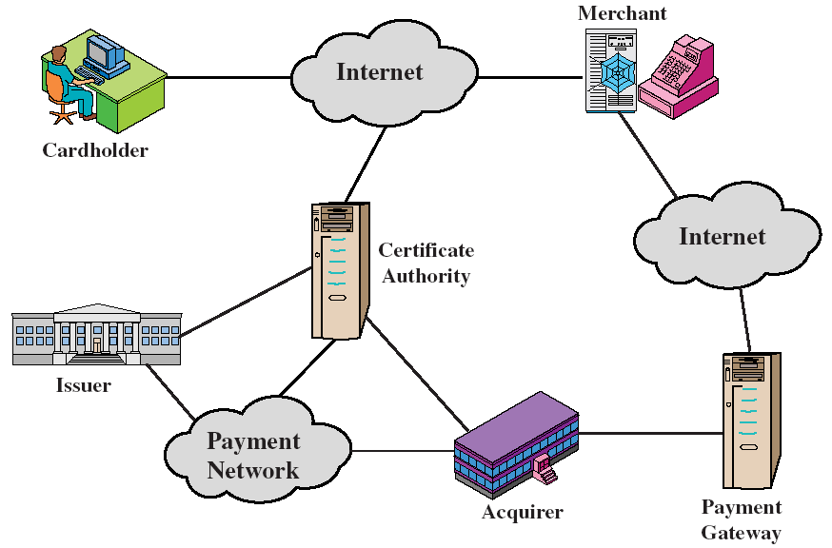

Slide 41
Implementation of SET
Data Confidentiality
Who am I dealing with?
Message integrity
Non-repudiation
Access Control
➔ Encryption
➔ Authentication
➔ Message Digest
➔ Digital Signature
➔ Certificate Attributes

Slide 42

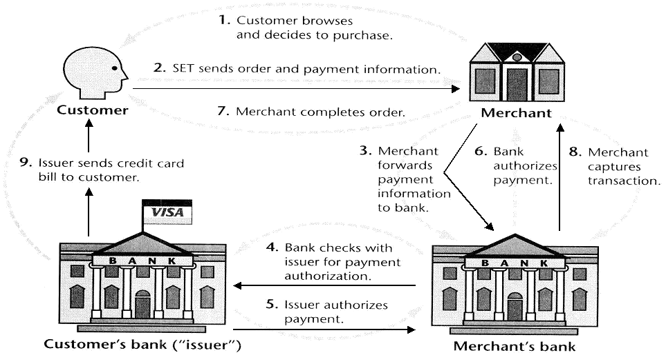

Slide 43
SET Transactions
The customer sends order and payment information to the merchant.
The merchant requests payment authorization from the payment gateway prior to shipment.
The merchant confirms order to the customer.
The merchant provides the goods or service to the customer.
The merchant requests payment from the payment gateway.

Slide 44
Key Technologies of SET
Confidentiality of information:
Encryption
Integrity of data: RSA digital signatures with SHA-1 hash codes etc
Cardholder account authentication:
  9v3 digital certificates with RSA signatures
Merchant authentication:
  9v3 digital certificates with RSA signatures
Privacy: separation of order and payment information using dual signatures

Slide 45
Dual Signatures for SET
Concept: Link Two Messages Intended for Two Different Receivers:
  Order Information (OI): Customer to Merchant
  Payment Information (PI): Customer to Bank
Goal: Limit Information to A “Need-to-Know” Basis:
  Merchant does not need credit card number.
  Bank does not need details of customer order.
  Afford the customer extra protection in terms of privacy by keeping
these items separate.
This link is needed to prove that payment is intended for this order and not some other one.

Slide 46
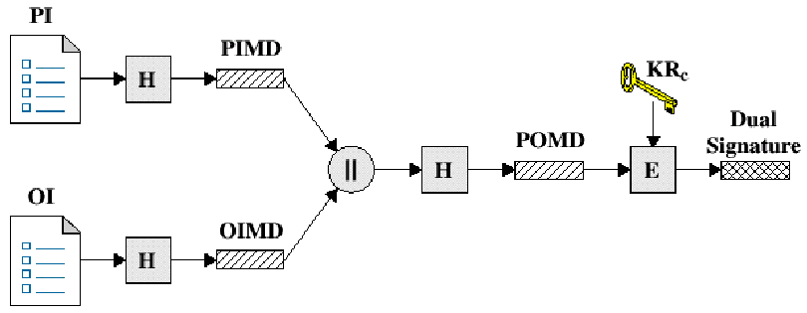
Dual Signature Operation
The operation for dual signature is as follows:
Take the hash (SHA-1) of the payment and order information.
These two hash values are concatenated [H(PI) || H(OI)] and
then the result is hashed.
Customer encrypts the final hash with a private key creating the dual signature.
DS = E_{KRC} [ H(H(PI) || H(OI)) ]

Slide 47
SET Supported Transactions
purchase notification
sale transaction
authorization reversal
capture reversal
credit reversal
card holder registration
merchant registration
purchase request
payment authorization
payment capture
certificate query
purchase inquiry

Slide 48
Credit Card Protocols
SSL (System Session Layer ) 1 or 2 parties have private keys
TLS (Transport Layer Security)
SEPP (Secure Encryption Payment Protocol)
  MasterCard, IBM, Netscape
STT (Secure Transaction Technology)
  VISA, Microsoft
SET (Secure Electronic Transactions)
  MasterCard, VISA all parties have certificates

Slide 49
Payment Process
The payment process is broken down into two steps:
  Payment authorization
  Payment capture

Slide 50
  Payment authorization
The merchant sends an authorization request message to the payment gateway consisting of the following:
  Purchase-related information
    PI
    Dual signature calculated over the PI & OI and signed with customer’s private key.
    The OI message digest (OIMD)
    The digital envelop
  Authorization-related information
  Certificates

Slide 51
Payment Authorization (cont’d)
Authorization-related information
  An authorization block including:
    A transaction ID
    Signed with merchant’s private key
    Encrypted one-time session key
Certificates
  Cardholder’s signature key certificate
  Merchant’s signature key certificate
  Merchant’s key exchange certificate

Slide 52
Payment: Payment Gateway
Verify All Certificates
Decrypt Authorization Block Digital Envelope to Obtain Symmetric Key and Decrypt Block
Verify Merchant Signature on Authorization Block
Decrypt Payment Block Digital Envelope to Obtain
Symmetric Key and Decrypt Block
Verify Dual Signature on Payment Block
Verify Received Transaction ID Received from Merchant Matches PI Received from Customer
Request and Receive Issuer Authorization

Slide 53
IP Security Overview
The standard Internet communication protocol is completely unprotected, allowing hosts to inspect or modify data in transit. Adding IPSec to the system will resolve this limitation by providing strong encryption, integrity, authentication and replay protection.

Slide 54
IP SECURITY
IPSec (IP Security) architecture uses two protocols to secure the traffic or data flow.
These protocols are ESP (Encapsulation Security Payload) and AH (Authentication Header).
IPSec Architecture include protocols, algorithms, DOI, and Key Management.
All these components are very important in order to provide the three main services:
  Authentication
  Confidentiality
  Key management

Slide 55
Authentication- The authentication mechanism ensures that the received packet was sent by the identified source. It also assures that the packet has not been altered in transit.
Confidentiality- The confidentiality facility enables communicating nodes to encrypt messages to prevent eavesdopping by third parties.
Key management- It is concerned with secure exchange of keys

Slide 56
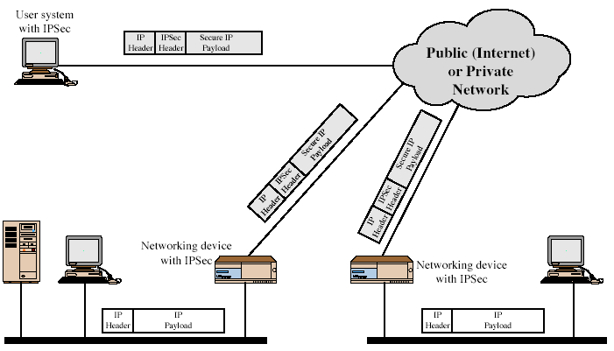
IP Security Scenario
Notes:
Stallings Fig 16-1.

Slide 57
Applications of IP Security
Secure branch office connectivity over the Internet.
Secure remote access over the Internet.
Establishing extranet and intranet connectivity with partners.
Enhancing electronic commerce security

Slide 58
Benefits of IPSec
Provides strong security when implemented in a firewall or router that can be applied to all traffic crossing the perimeter.
IPsec is resistant to bypass if all traffic from the outside must use IP and the firewall is the only way of entrance from the Internet into the organization.
Is below transport layer, hence transparent to applications.
Can be transparent to end users.
Can provide security for individual users if needed.

Slide 59
IPsec Documents
Architecture – Covers the general concept security
requirements, definitions, and mechanisms defining IPsec technology.
Authentication Header(AH)- An extension header to provide message authentication. Current specification is RFC 4302.
Encapsulating Security Payload- Consists of an encapsulating header and trailer used to provide encryption or combined encryption/authentication. Current specification is RFC 4303.
Internet Key Exchange(IKE)- A collection of documents describing the
key management schemes for use with IPsec.
Cryptographic algorithms- Includes a large set of documents that define and describe cryptographic algorithms for encryption, message authentication, pseudo random functions, and cryptographic key exchange.
Domain of Interpretation- Contains values needed for the other documents to relate to each other. These include identifiers for approved encryption and authentication algorithms, as well as operational parameters such as key lifetime

Slide 60

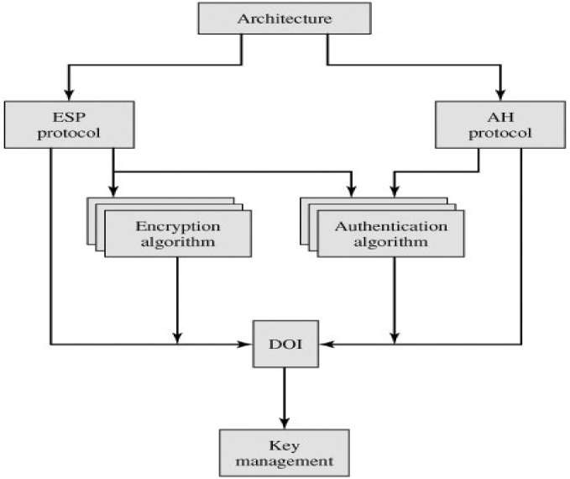

Slide 61
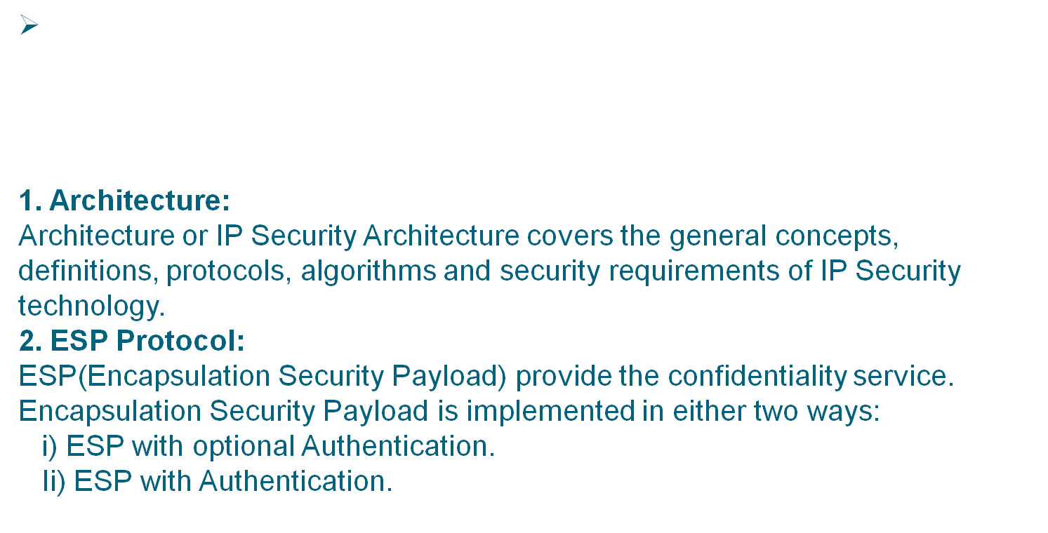

Slide 62
IPSec Security Services
Connectionless integrity
Assurance that received traffic has not been modified.
Integrity includes anti-reply defenses.
Data origin authentication
Assurance that traffic is sent by legitimate party or parties.
Confidentiality (encryption)
Assurance that user’s traffic is not examined by non-authorized parties.
Access control
Prevention of unauthorized use of a resource.
Limited traffic flow confidentiality

Slide 63
Security Associations
A one-way relationship between a sender and a receiver that affords security services to the traffic carried on it.
A security association is uniquely identified by three parameters:
Security Parameters Index (SPI): A bit string assigned to this SA and having local significance only. The SPI is carried in AH and ESP headers to enable the receiving system to select the SA under which a received packet will be processed.
IP Destination Address: Currently, only unicast addresses are allowed; this is the address of the destination endpoint of the
SA, which may be an end user system or a network system such as a firewall or router.
Security Protocol Identifier: This indicates whether the association is an AH or ESP security association

Slide 64
Security Association Parameters
Security Association Database defines the parameters associated with each SA. A security association is normally defined by the following parameters:
Sequence Number Counter: A 32-bit value used to generate the Sequence Number field in AH or ESP headers.
Sequence Counter Overflow: A flag indicating whether overflow of the Sequence Number Counter should generate an auditable event and prevent further transmission of packets on this SA (required for all implementations).
Anti-Replay Window: Used to determine whether an inbound AH or ESP packet is a replay.
AH Information: Authentication algorithm, keys, key
lifetimes, and related parameters being used with AH (required for AH implementations).

Slide 65
Security Association Parameters
ESP Information: Encryption and authentication algorithm, keys, initialization values, key lifetimes, and related parameters being used with ESP (required for ESP implementations).
Lifetime of This Security Association: A time interval or byte count after which an SA must be replaced with a new SA (and new SPI) or terminated, plus an indication of which of these actions should occur (required for all implementations).
IPSec Protocol Mode: Tunnel, transport, or wildcard (required for all implementations).
Path MTU: Any observed path maximum transmission unit (maximum size of a packet that can be transmitted without fragmentation) and aging variables (required for all implementations).

Slide 66
Security Association Selectors
The means by which IP traffic is related to specific SAs (or no SA in the case of traffic allowed to bypass IPSec) is the nominal Security Policy Database (SPD).
The following selectors determine an SPD entry:
Destination IP Address: This may be a single IP address, an enumerated list or range of addresses, or a wildcard (mask) address. The latter two are required to support more than one destination system sharing the same SA (e.g., behind a firewall).
Source IP Address: This may be a single IP address, an enumerated list or range of addresses, or a wildcard (mask) address. The latter two are required to support more than one source system sharing the same SA (e.g., behind a firewall).
UserID: A user identifier from the operating system. This is not a field in the IP or upper-layer headers but is available if IPSec is running on the same operating system as the user.

Slide 67
Security Association Selectors
Data Sensitivity Level: Used for systems providing information flow security (e.g., Secret or Unclassified).
Transport Layer Protocol: Obtained from the IPv4 Protocol or IPv6 Next Header field. This may be an individual protocol number, a list of protocol numbers, or a range of protocol numbers.
Source and Destination Ports: These may be individual TCP or UDP port values, an enumerated list of ports, or a wildcard port.

Slide 68
IPSec Modes of Operation
Both AH and ESP supports two modes of use:
Transport mode –Provides protection primarily for upper layer protocols.ESP in transport mode encrypts and optionally authenticates the IP payload but not the IP header. AH authenticates the IP payload and selected portions of the IP header.
Tunnel mode - Provides protection to the entire IP packet. After the AH or ESP fields are added to the IP packet, the entire packet plus security fields is treated as payload of new outer packet with a new outer IP header.

Slide 69
IPSec Modes of Operation
Transport Mode: protect the upper layer protocols
Original IP
Datagram
Transport Mode protected packet protected
  Tunnel Mode: protect the entire IP payload
Tunnel Mode protected packet
protected
IP Header | TCP Header | Data
IP Header | IPSec Header | TCP Header | Data
New IP Header | IPSec Header | Original IP Header | TCP Header | Data

Slide 70
Transport mode vs. Tunnel mode functionalities
Transport Mode SA
Tunnel Mode SA
AH
Authenticates IP payload and selected portions of IP header and IPv6 extension headers
Authenticates entire inner IP packet plus selected portions of outer IP header
ESP
Encrypts IP payload and any IPv6 extesion header
Encrypts inner IP packet
ESP with authentication
Encrypts IP payload and any IPv6 extesion header. Authenticates IP payload but no IP header
Encrypts inner IP packet. Authenticates inner IP packet.

Slide 71
Authentication Header
Provides support for data integrity and authentication of IP packets.
Authentication is based on the use of a message authentication code (MAC), hence the two parties must share a secret key.

Slide 72
Authentication Header
The Authentication Header consists of the following fields :
Next Header (8 bits): Identifies the type of header
immediately following this header.
Payload Length (8 bits): Length of Authentication Header in 32-bit words, minus 2.
Reserved (16 bits): For future use.
Security Parameters Index (32 bits): Identifies a security association.
Sequence Number (32 bits): A monotonically increasing counter value
Authentication Data (variable): A variable-length field (must be an integral number of 32-bit words) that contains the Integrity Check Value (ICV), or MAC

Slide 73

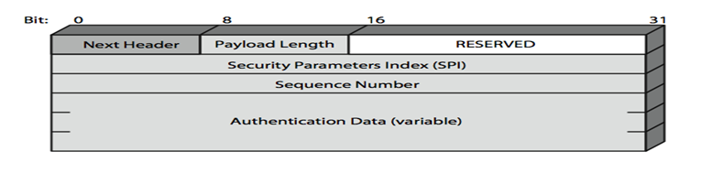

Slide 74
Encapsulating Security Payload (ESP)
provides message content confidentiality & limited traffic flow confidentiality
can optionally provide the same authentication services as AH
Because message authentication is provided by ESP, the use of AH is deprecated
supports range of ciphers, modes, padding
  incl. DES, Triple-DES, RC5, IDEA, CAST etc
  CBC & other modes
  padding needed to fill blocksize, fields, for traffic flow

Slide 75

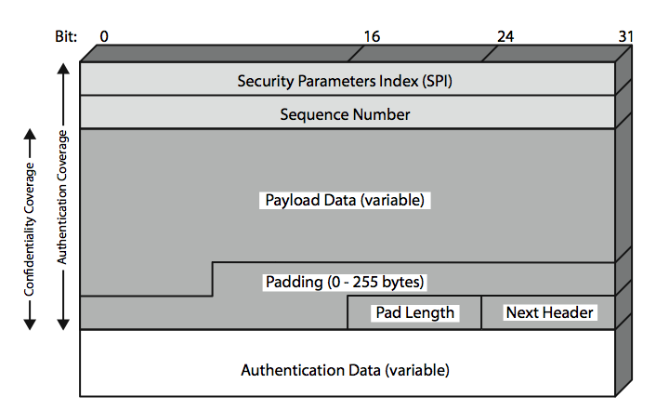
Fig. ESP Formt

Slide 76
Encapsulating Security Payload
Security Parameters Index (32 bits): Identifies a security association
Sequence Number (32 bits): A monotonically increasing counter value; this provides an anti-replay function
Payload Data (variable): This is a transport-level segment (transport mode) or IP packet (tunnel mode) that is protected by encryption
Padding (0–255 bytes): for various reasons
Pad Length (8 bits): Indicates the number of pad bytes immediately preceding this field
Next Header (8 bits): Identifies the type of data contained in the payload data field by identifying the first header in that payload
Integrity Check Value (variable): A variable-length field that contains the Integrity Check Value computed over the ESP packet minus the Authentication Data field

Slide 77
Anti-Replay Service
A replay attack is one in which an attacker obtains a copy of an authenticated packet and later transmits it to the intended destination. The receipt of duplicate, authenticated IP packets may disrupt service in some way or may have some other undesired consequence.
The Sequence Number field is designed to thwart such attacks.
When a new SA is established, the sender initializes a sequence number counter to 0.
If anti-replay is enabled (the default), the sender must not allow the sequence number to cycle past 2³² -1 back to zero. Otherwise, there would be multiple valid packets with the same sequence number. If the limit of 2 ³² -1 is reached, the sender should terminate this SA and negotiate a new SA with a new key.

Slide 78
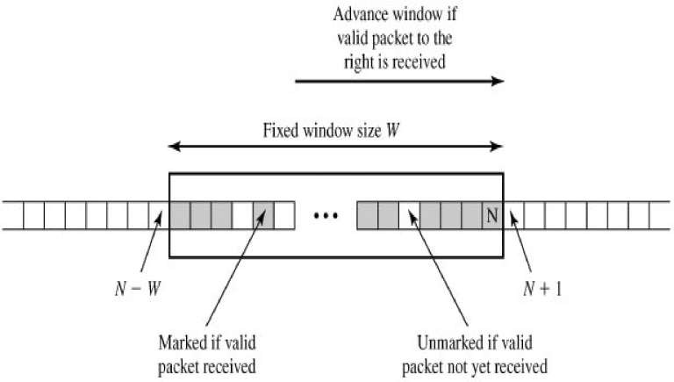
Anti-Replay Service
with a default of W = 64
Fig. Antireplay Mechanism

Slide 79
Transport vs Tunnel Mode ESP
transport mode is used to encrypt & optionally authenticate IP data
  data protected but header left in clear
  can do traffic analysis but is efficient
  good for ESP host to host traffic
tunnel mode encrypts entire IP packet
  add new header for next hop
  good for VPNs, gateway to gateway security

Slide 80
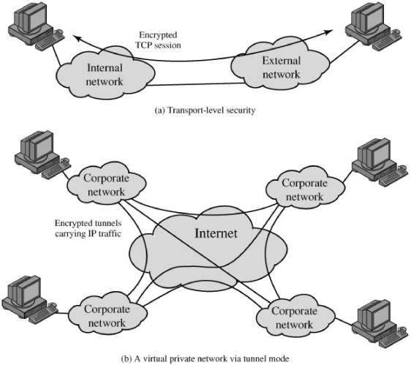
Transport vs Tunnel Mode ESP
Fig. Transport-Mode vs. Tunnel-Mode Encryption

Slide 81
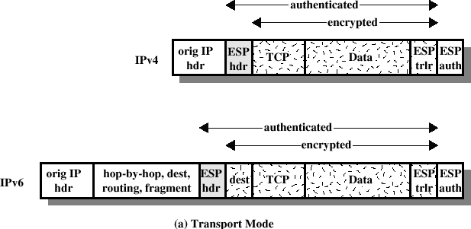
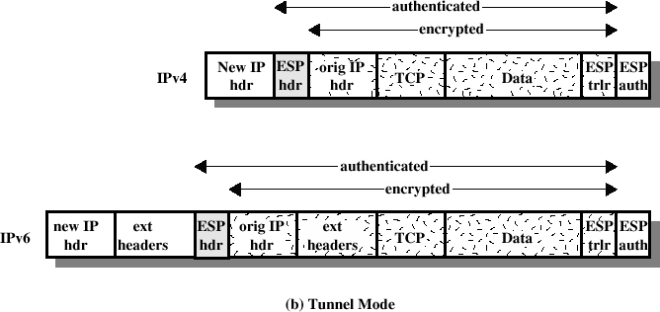
Transport vs Tunnel Mode ESP
Fig. Scope of ESP Encryption and Authentication

Slide 82
Combining Security Associations
SA’s can implement either AH or ESP
to implement both need to combine SA’s
  form a security association bundle
  may terminate at different or same endpoints
  combined by
 transport adjacency
 iterated tunneling
issue of authentication & encryption order

Slide 83
Authentication Plus Confidentiality
Transmitting IP packet that has both confidentiality and authentication between hosts
ESP with Authentication Option: Authentication after encryption using Transport mode ESP or Tunnel mode ESP.
Transport Adjacency: Another way to apply Authentication after encryption
Use two bundled transport SAs, with the inner being an ESP SA and the outer
being an AH SA.
Here ESP is used without authentication option.
Advantage: Authentication covers more fields, including the source and destination IP addresses.
Disadvantage: Overhead of two SAs vs one SA.
3) Transport-Tunnel Bundle: Authentication before encryption
Use a bundle consisting of an inner AH transport SA and an outer ESP tunnel SA.
Advantages:
Impossible to intercept the message and alter the authentication data without detection.
Authentication information with the message may be stored at the destination for later references.

Slide 84
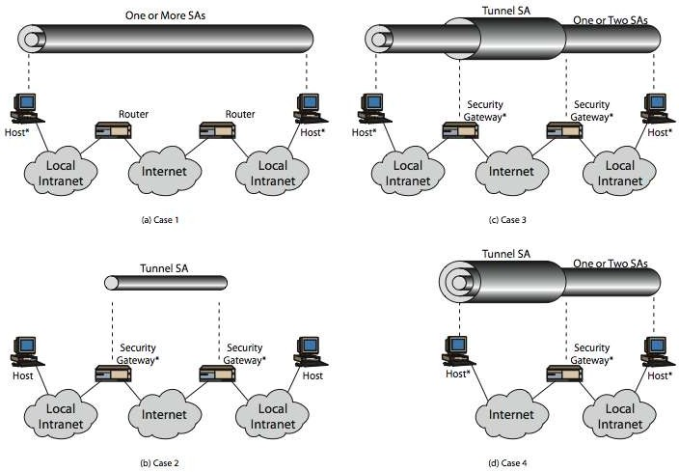
Basic Combinations of Security Associations
Fig. Basic Combinations of Security Associations

Slide 85
Key Management
handles key generation & distribution
typically need 2 pairs of keys
  2 per direction for AH & ESP
manual key management
  System administrator manually configures every system
automated key management
  automated system for on demand creation of keys for SA’s in large systems
  has Oakley & ISAKMP elements

Slide 86
INTERNET KEY EXCHANGE (IKE)
Internet Key Exchange (IKE) is the protocol used to set up a secure, authenticated communications channel between two parties.
IKE typically uses X.509 PKI certificates for authentication and the Diffie–Hellman key exchange protocol to set up a shared session secret.
IKE is part of the Internet Security Protocol (IPSec) which is responsible for negotiating security associations (SAs), which are a set of mutually agreed-upon keys and algorithms to be used by both parties trying to establish a VPN connection/tunnel.

Slide 87
IKE is comprised of two phases. In phase 1, IKE creates an authenticated, secure channel between the two IKE peers. This is done using the Diffie-Hellman key agreement protocol. IKE supports multiple authentication methods as part of the phase 1 exchange. Methods include:
Pre-shared keys. A key value entered into each peer manually (out of band) and used to authenticate the peer.
RSA signatures. Uses a digital certificate authenticated by an RSA signature.
RSA encrypted nonces. Uses RSA encryption to encrypt a nonce value (a random number generated by the peer).
In phase 2, IKE negotiates the IPSec security associations and generates the required key material for IPSec.

Slide 88
Firewalls

Slide 89
Firewall is a network device that isolates organization's internal network from larger outside network/Internet. It can be a hardware, software, or combined system that prevents unauthorized access to or from internal network.
A firewall is a network security device, either hardware or software-based, which monitors all incoming and outgoing traffic and based on a defined set of security rules it accepts, rejects or drops that specific traffic.
Accept : allow the traffic
Reject : block the traffic but reply with an “unreachable error”
Drop : block the traffic with no reply
A firewall establishes a barrier between secured internal networks and outside untrusted network, such as the Internet.

Slide 90
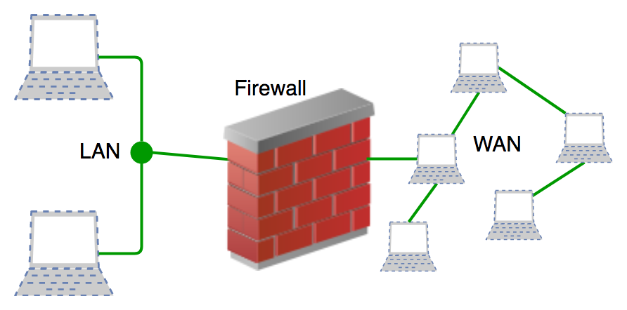
Basic Structure of Firewall

Slide 91
History and Need for Firewall
Before Firewalls, network security was performed by Access Control Lists (ACLs) residing on routers.
ACLs are rules that determine whether network access should be granted or denied to specific IP address.
But ACLs cannot determine the nature of the packet it is blocking. Also, ACL alone does not have the capacity to keep threats out of the network.
Hence, the Firewall was introduced.

Slide 92
Connectivity to the Internet is no longer optional for organizations.
However, accessing the Internet provides benefits to the organization; it also enables the outside world to interact with the internal network of the organization.
This creates a threat to the organization. In order to secure the internal network from unauthorized traffic, we need a Firewall.

Slide 93
How Firewall Works
Firewall match the network traffic against the rule set defined in its table.
Once the rule is matched, associate action is applied to the network traffic.
For example, Rules are defined as any employee from HR department cannot access the data from code server and at the same time another rule is defined like system administrator can access the data from both HR and technical department.
Rules can be defined on the firewall based on the necessity and security policies of the organization.

Slide 94
From the perspective of a server, network traffic can be either outgoing or incoming.
Firewall maintains a distinct set of rules for both the cases. Mostly the outgoing traffic, originated from the server itself, allowed to pass. Still, setting a rule on outgoing traffic is always better in order to achieve more security and prevent unwanted communication.
Incoming traffic is treated differently. Most traffic which reaches on the firewall is one of these three major Transport Layer protocols- TCP, UDP or ICMP.
All these types have a source address and destination address. Also, TCP and UDP have port numbers. ICMP uses type code instead of port number which identifies purpose of that packet.

Slide 95
Default policy:
It is very difficult to explicitly cover every possible rule on the firewall. For this reason, the firewall must always have a default policy.
Default policy only consists of action (accept, reject or drop).
Suppose no rule is defined about SSH connection to the server on the firewall.
So, it will follow the default policy. If default policy on the firewall is set to accept, then any computer outside of your office can establish an SSH connection to the server.
Therefore, setting default policy as drop (or reject) is always a good practice.

Slide 96
Generation of Firewall
Firewalls can be categorized based on its generation.
First Generation- Packet Filtering Firewall :
Packet filtering firewall is used to control network access by monitoring outgoing and incoming packet and allowing them to pass or stop based on source and destination IP address, protocols and ports.
It analyses traffic at the transport protocol layer (but mainly uses first 3layers).
Packet firewalls treat each packet in isolation.
They have no ability to tell whether a packet is part of an existing stream of traffic. Only It can allow or deny the packets based on unique packet headers.

Slide 97
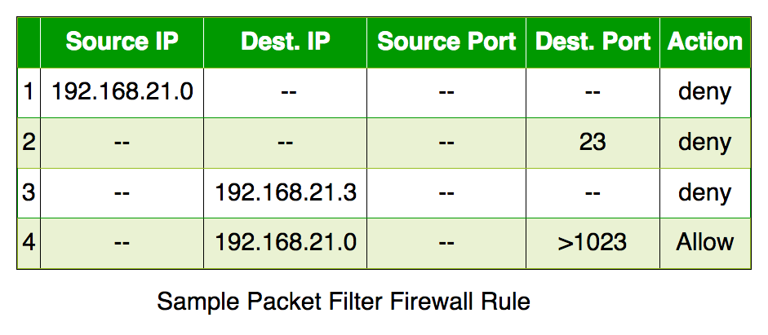
Packet filtering firewall maintains a filtering table which decides whether the packet will be forwarded or discarded. From the given filtering table, the packets will be Filtered according to following rules:
Incoming packets from network 192.168.21.0 are blocked.
Incoming packets destined for internal TELNET server (port 23) are blocked.
Incoming packets destined for host 192.168.21.3 are blocked.
All well-known services to the network 192.168.21.0 are allowed.

Slide 98
Firewalls – Packet Filters
simplest, fastest firewall component
foundation of any firewall system
examine each IP packet (no context) and permit or deny according to rules
hence restrict access to services (ports)
possible default policies
  that not expressly permitted is prohibited
  that not expressly prohibited is permitted
Notes:
Have three common types of firewalls: packet filters, application-level gateways, & circuit-level gateways.
A packet-filtering router applies a set of rules to each incoming and outgoing IP packet to forward or discard the packet. Filtering rules are based on information contained in a network packet such as src & dest IP addresses, ports, transport protocol & interface. Some advantages are simplicity, transparency & speed.
If there is no match to any rule, then one of two default policies are applied:
• that which is not expressly permitted is prohibited (default action is discard packet), conservative policy
• that which is not expressly prohibited is permitted (default action is forward packet), permissive policy

Slide 99
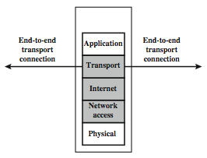
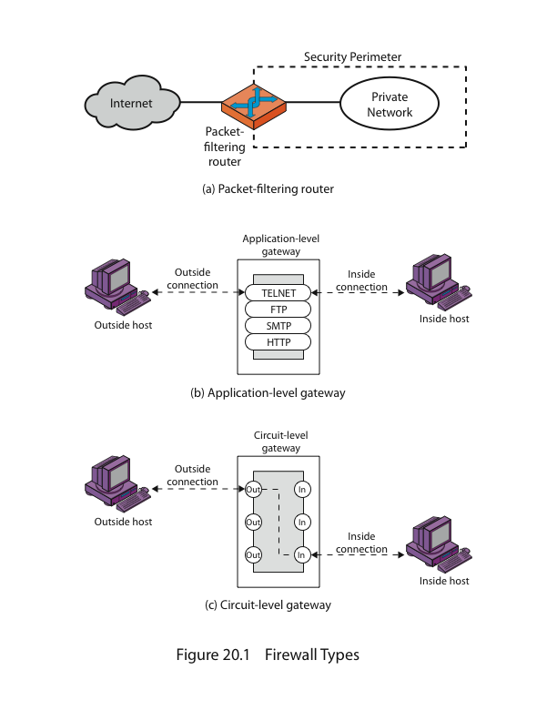
Firewalls – Packet Filters
Notes:
Stallings Figure 22.1b (along with 4/e Figure 20.1a) illustrates the packet filter firewall role as utilising information from the transport, network & data link layers to make decisions on allowable traffic flows, and its placement in the border router between the external less-trusted Internet and the internal more trusted private network.

Slide 100
Attacks on Packet Filters
IP address spoofing
  fake source address to be trusted
  add filters on router to block
source routing attacks
  attacker sets a route other than default
  block source routed packets
tiny fragment attacks
  split header info over several tiny packets
  either discard or reassemble before check
Notes:
Some of the attacks that can be made on packet-filtering routers & countermeasures are:
• IP address spoofing: where intruder transmits packets from the outside with internal host source IP addr, need to filter & discard such packets
• Source routing attacks: where source specifies the route that a packet should take to bypass security measures, should discard all source routed packets
• Tiny fragment attacks: intruder uses the IP fragmentation option to create extremely small fragments and force the TCP header information into a separate fragments to circumvent filtering rules needing full header info, can enforce minimum fragment size to include full header.

Slide 101
2.Second Generation-
Stateful Inspection Firewall
Stateful firewalls (performs Stateful Packet Inspection) are able to determine the connection state of packet, unlike Packet filtering firewall, which makes it more efficient.
It keeps track of the state of networks connection travelling across it, such as TCP streams.
So the filtering decisions would not only be based on defined rules, but also on packet’s history in the state table.

Slide 102
Firewalls – Stateful Packet Filters
traditional packet filters do not examine higher layer context
  ie matching return packets with outgoing flow
stateful packet filters address this need
they examine each IP packet in context
  keep track of client-server sessions
  check each packet validly belongs to one
hence are better able to detect bogus packets out of context
may even inspect limited application data
Notes:
A traditional packet filter makes filtering decisions on an individual packet basis and does not take into consideration any higher layer context. In general, when an application that uses TCP creates a session with a remote host, it creates a TCP connection in which the TCP port number for the remote (server) application is a number less than 1024 and the TCP port number for the local (client) application is a number between 1024 and 65535. A simple packet filtering firewall must permit inbound network traffic on all these high- numbered ports for TCP-based traffic to occur. This creates a vulnerability that can be exploited by unauthorized users. A stateful inspection packet filter tightens up the rules for TCP traffic by creating a directory of outbound TCP connections, and will allow incoming traffic to high-numbered ports only for those packets that fit the profile of one of the entries in this directory. Hence they are better able to detect bogus packets sent out of context. A stateful packet inspection firewall reviews the same packet information as a packet filtering firewall, but also records information about TCP connections. Some stateful firewalls also keep track of TCP sequence numbers to prevent attacks that depend on the sequence number, such as session hijacking. Some even inspect limited amounts of application data for some well-known protocols like FTP, IM and SIPS commands, in order to identify and track related connections.

Slide 103
3.Third Generation- Application Layer Firewall
Application layer firewall can inspect and filter the packets on any OSI layer, up to the application layer.
It has the ability to block specific content, also recognize when certain application and protocols (like HTTP, FTP) are being misused.
In other words, Application layer firewalls are hosts that run proxy servers.
A proxy firewall prevents the direct connection between either side of the firewall, each packet has to pass through the proxy.
It can allow or block the traffic based on predefined rules.

Slide 104
Firewalls - Application Level Gateway (or Proxy)
have application specific gateway / proxy
has full access to protocol
  user requests service from proxy
  proxy validates request as legal
  then actions request and returns result to user
  can log / audit traffic at application level
need separate proxies for each service
  some services naturally support proxying
  others are more problematic
Notes:
An application-level gateway (or proxy server), acts as a relay of application-level traffic. A user contacts the gateway to access some service, provides details of the service, remote host & authentication details, contacts the application on the remote host and relays all data between the two endpoints. If the gateway does not implement the proxy code for a specific application, then it is not supported and cannot be used. Note that some services naturally support proxying, whilst others are more problematic. Application-level gateways tend to be more secure than packet filters, &can log and audit traffic at application level.

Slide 105
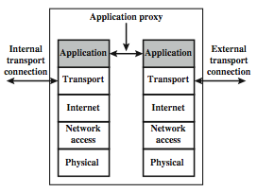
Firewalls - Application Level Gateway (or Proxy)
Notes:
Stallings Figure 22.1d (along with 4/e Figure 20.1b) illustrates an application-level gateway (or proxy server), emphasizing that it only supports a specific list of application services.

Slide 106
4.Next Generation Firewalls (NGFW)
Next Generation Firewalls are being deployed these days to stop modern security breaches like advance malware attacks and application-layer attacks.
NGFW consists of Deep Packet Inspection, Application Inspection, SSL/SSH inspection and many functionalities to protect the network from these modern threats.

Slide 107
Firewalls - Circuit Level Gateway
relays two TCP connections
imposes security by limiting which such connections are allowed
once created usually relays traffic without examining contents
typically used when trust internal users by allowing general outbound connections
SOCKS is commonly used
Notes:
A fourth type of firewall is the circuit-level gateway or circuit-level proxy. This can be a stand-alone system or it can be a specialized function performed by an application-level gateway for certain applications. A circuit-level gateway relays two TCP connections, one between itself and an inside TCP user, and the other between itself and a TCP user on an outside host. Once the two connections are established, it relays TCP data from one connection to the other without examining its contents. The security function consists of determining which connections will be allowed. It is typically used when internal users are trusted to decide what external services to access.
One of the most common circuit-level gateways is SOCKS, defined in RFC 1928. It consists of a SOCKS server on the firewall, and a SOCKS library & SOCKS-aware applications on internal clients. When a TCP-based client wishes to establish a connection to an object that is reachable only via a firewall (such determination is left up to the implementation), it must open a TCP connection to the appropriate SOCKS port on the SOCKS server system. If the connection request succeeds, the client enters a negotiation for the authentication method to be used, authenticates with the chosen method, and then sends a relay request. The SOCKS server evaluates the request and either establishes the appropriate connection or denies it. UDP exchanges are handled in a similar fashion.

Slide 108
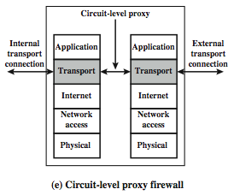
Firewalls - Circuit Level Gateway
Notes:
Stallings Figure 22.1e (along with 4/e Figure 20.1c) illustrates a circuit-level gateway, showing how it relays between 2 TCP connections. Note that it can be implemented in a stand-alone system or can be a specialized function in an application-level gateway for certain applications. Note also that relaying UDP packets is more problematical, because of the lack of connection context, and require a parallel TCP connection to provide these details.

Slide 109
Types of Firewall
Firewalls are generally of two types:
Host-based and
Network-based.

Slide 110
Host- based Firewalls
Host-based firewall is installed on each network node which controls each incoming and outgoing packet.
It is a software application or suite of applications, comes as a part of the operating system.
Host-based firewalls are needed because network firewalls cannot provide protection inside a trusted network.
Host firewall protects each host from attacks and unauthorized access.

Slide 111
Host-Based Firewalls
s/w module used to secure individual host
  available in many operating systems
  or can be provided as an add-on package
often used on servers
advantages:
  can tailor filtering rules to host environment
  protection is provided independent of topology
  provides an additional layer of protection
Notes:
A host-based firewall is a software module used to secure an individual host. Such modules are available in many operating systems or can be provided as an add-on package. Like conventional stand-alone firewalls, host-resident firewalls filter and restrict the flow of packets. A common location for such firewalls is a server. There are several advantages to the use of a server-based or workstation-based firewall:
• Filtering rules can be tailored to the host environment. Specific corporate security policies for servers can be implemented, with different filters for servers used for different application.
• Protection is provided independent of topology. Thus both internal and external attacks must pass through the firewall.
• Used in conjunction with stand-alone firewalls, the host-based firewall provides an additional layer of protection. A new type of server can be added to the network, with its own firewall, without the necessity of altering the network firewall configuration.

Slide 112
Network-based Firewalls
Network firewall function on network level.
In other words, these firewalls filter all incoming and outgoing traffic across the network.
It protects the internal network by filtering the traffic using rules defined on the firewall.
A Network firewall might have two or more network interface cards (NICs).
A network-based firewall is usually a dedicated system with proprietary software installed.

Slide 113
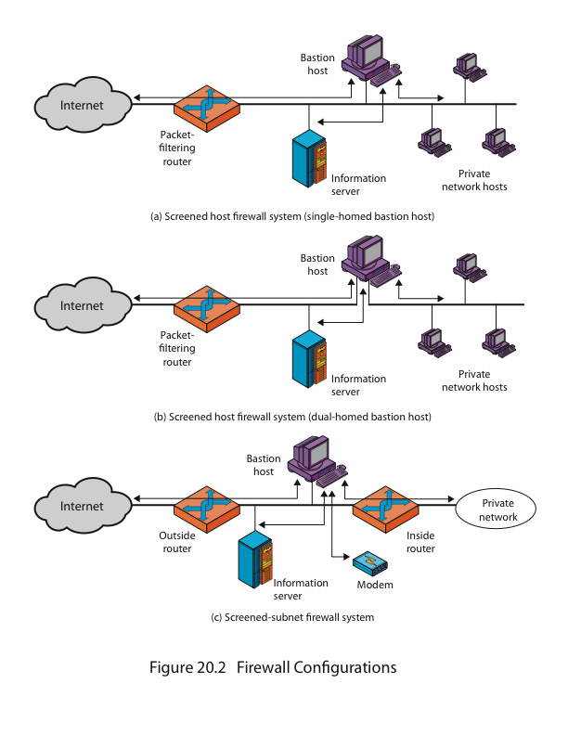
Firewall Configurations
Notes:
As Figure 22.1a indicates, a firewall is positioned to provide a protective barrier between an external, potentially untrusted source of traffic and an internal network. With that general principle in mind, a security administrator must decide on the location and on the number of firewalls needed.
In addition to the use of a simple configuration consisting of a single system, more complex configurations are possible and indeed more common. Stallings 4/e Figure 20.2 illustrates three common firewall configurations.
4/e Figure 20.2a shows the “screened host firewall, single-homed bastion configuration”, where the firewall consists of two systems:
a packet-filtering router - allows Internet packets to/from bastion only
a bastion host - performs authentication and proxy functions
This configuration has greater security, as it implements both packet-level & application-level filtering, forces an intruder to generally penetrate two separate systems to compromise internal security, & also affords flexibility in providing direct Internet access to specific internal servers (eg web) if desired.

Slide 114
Firewall Configurations
Notes:
Stallings 4/e Figure 20.2b illustrates the “screened host firewall, dual-homed bastion configuration” which physically separates the external and internal networks, ensuring two systems must be compromised to breach security. The advantages of dual layers of security are also present here. Again, an information server or other hosts can be allowed direct communication with the router if this is in accord with the security policy, but are now separated from the internal network.

Slide 115
Firewall Configurations
Notes:
Stallings 4/e Figure 20.2c shows the “screened subnet firewall configuration”, being the most secure shown. It has two packet-filtering routers, one between the bastion host and the Internet and the other between the bastion host and the internal network, creating an isolated subnetwork. This may consist of simply the bastion host but may also include one or more information servers and modems for dial-in capability. Typically, both the Internet and the internal network have access to hosts on the screened subnet, but traffic across the screened subnet is blocked.
This configuration offers several advantages:
• There are now three levels of defense to thwart intruders
• The outside router advertises only the existence of the screened subnet to the Internet; therefore the internal network is invisible to the Internet
• Similarly, the inside router advertises only the existence of the screened subnet to the internal network; hence systems on the inside network cannot construct direct routes to the Internet

Slide 116
Firewall Deployment with DMZ
A firewall is a mechanism used to control network traffic ‘into’ and ‘out’ of an organizational internal network. In most cases these systems have two network interfaces, one for the external network such as the Internet and the other for the internal side.
The firewall process can tightly control what is allowed to traverse from one side to the other. An organization that wishes to provide external access to its web server can restrict all traffic arriving at firewall expect for port 80 (the standard http port).
All other traffic such as mail traffic, FTP, SNMP, etc., is not allowed across the firewall into the internal network. An example of a simple firewall is shown in the following diagram.

Slide 117
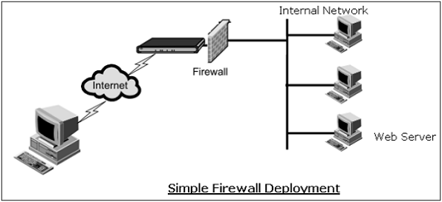
In the above simple deployment, though all other accesses from outside are blocked, it is possible for an attacker to contact not only a web server but any other host on internal network that has left port 80 open by accident or otherwise.

Slide 118
Hence, the problem most organizations face is how to enable legitimate access to public services such as web, FTP, and e-mail while maintaining tight security of the internal network. The typical approach is deploying firewalls to provide a Demilitarized Zone (DMZ) in the network.
In this setup (illustrated in following diagram), two firewalls are deployed; one between the external network and the DMZ, and another between the DMZ and the internal network. All public servers are placed in the DMZ.
With this setup, it is possible to have firewall rules which allow public access to the public servers but the interior firewall can restrict all incoming connections. By having the DMZ, the public servers are provided with adequate protection instead of placing them directly on external network.

Slide 119
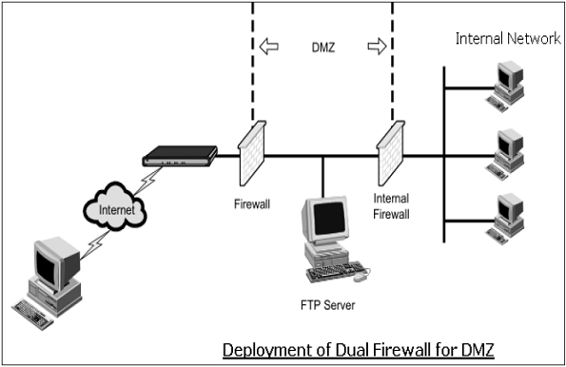
Notes:
Stallings Figure 22.3 further illustrates the use of a “screened subnet”, also known as a demilitarized zone (DMZ), located between an internal and an external firewall. An external firewall is placed at the edge of a local or enterprise network, just inside the boundary router that connects to the Internet or some wide area network (WAN). One or more internal firewalls protect the bulk of the enterprise network. Systems that are externally accessible but need some protections are usually located on DMZ networks. Typically, the systems in the DMZ require or foster external connectivity, such as a corporate Web site, an e-mail server, or a DNS (domain name system) server. The external firewall provides a measure of access control and protection for the DMZ systems consistent with their need for external connectivity. The external firewall also provides a basic level of protection for the remainder of the enterprise network. In this type of configuration, internal firewalls serve three purposes:
The internal firewall adds more stringent filtering capability, vs the external firewall, to protect enterprise servers and workstations from external attack.
The internal firewall provides two-way protection with respect to the DMZ, as it protects the remainder of the network from attacks launched from DMZ systems, and protects DMZ systems from attack by internal hosts.
Multiple internal firewalls can be used to protect portions of the internal network from each other.
A common practice is to place the DMZ on a different network interface on the external firewall from that used to access the internal networks.

Slide 120
Intrusion Detection / Prevention System
The packet filtering firewalls operate based on rules involving TCP/UDP/IP headers only. They do not attempt to establish correlation checks among different sessions.
Intrusion Detection/Prevention System (IDS/IPS) carry out Deep Packet Inspection (DPI) by looking at the packet contents. For example, checking character strings in packet against database of known virus, attack strings.
Application gateways do look at the packet contents but only for specific applications. They do not look for suspicious data in the packet. IDS/IPS looks for suspicious data contained in packets and tries to examine correlation among multiple packets to identify any attacks such as port scanning, network mapping, and denial of service and so on.

Slide 121
Difference between IDS and IPS
IDS and IPS are similar in detection of anomalies in the network. IDS is a ‘visibility’ tool whereas IPS is considered as a ‘control’ tool.
Intrusion Detection Systems sit off to the side of the network, monitoring traffic at many different points, and provide visibility into the security state of the network. In case of reporting of anomaly by IDS, the corrective actions are initiated by the network administrator or other device on the network.
Intrusion Prevention System are like firewall and they sit in-line between two networks and control the traffic going through them. It enforces a specified policy on detection of anomaly in the network traffic. Generally, it drops all packets and blocks the entire network traffic on noticing an anomaly till such time an anomaly is addressed by the administrator.

Slide 122
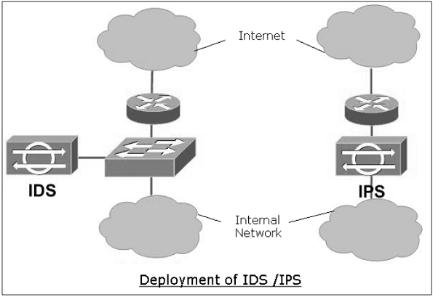

Slide 123
Types of IDS
There are two basic types of IDS.
Signature-based IDS
Anomaly-based IDS

Slide 124
Signature-based IDS
  It needs a database of known attacks with their signatures.
  Signature is defined by types and order of packets characterizing a particular attack.
  Limitation of this type of IDS is that only known attacks can be detected. This IDS can also throw up a false alarm. False alarm can occur when a normal packet stream matches the signature of an attack.
  Well-known public open-source IDS example is “Snort” IDS.

Slide 125
Anomaly-based IDS
  This type of IDS creates a traffic pattern of normal network operation.
  During IDS mode, it looks at traffic patterns that are statistically unusual. For example, ICMP unusual load, exponential growth in port scans, etc.
  Detection of any unusual traffic pattern generates the alarm.
  The major challenge faced in this type of IDS deployment is the difficulty in distinguishing between normal traffic and unusual traffic.

Slide 126
References
Cryptography and Network Security Principles and Practices, 4th Ed - William Stallings

